Slide 1


DATA SCIENCE PROFESSIONAL CERTIFICATE BY IBM APPLIED DATA SCIENCE CAPSTONE
DISTRICTS SEGMENTATION OF THE CITY OF HUESCA, SPAIN FOR ENTREPRENEURSHIP IN THE RESTAURANT SECTOR
By: Enrique Carrero
January, 2020

Slide 2
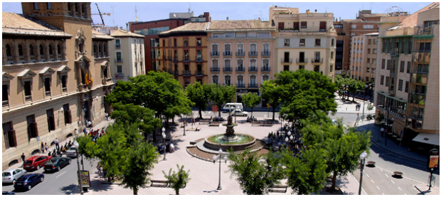
Outline
Business Problem
Data Collection
Methodology
Results
Discussion
Conclusion

Slide 3
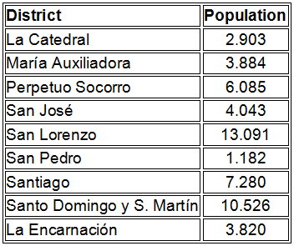
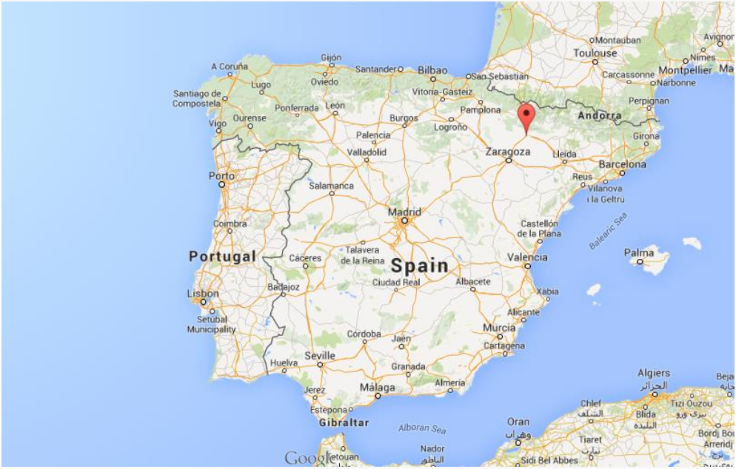
1. Business Problem
Huesca is a Spanish city and municipality, capital of the province of the same name, belonging to the autonomous community of Aragon. It has 53587 residents in 2019 distributed over an area of 161.03 km ².
San Lorenzo and Santo Domingo and San Martin are the most populated neighborhoods
Commerce and tourism are the pillars of the economy with 44.7% of the GDP. Specifically, the hotel and restaurant sector is very important in the city so “in this final project we will conduct an analysis to identify the best areas to open a venture in the area of restaurants as well as what types of restaurants are most suitable based on the platform Foursquare”.
Figure 1. Huesca geographical location.

Slide 4
2. Data Collection
The analysis carried out in this project is based on:
Information on the demographic distribution by districts of Huesca, available in a CSV file downloaded from the website of the city of Huesca.
https://www.huesca.es/la-ciudad/datos-de-ciudad/poblacion
Geographical location of the Huesca neighborhoods, this was obtained from the list of neighborhoods in CSV format mentioned above and the Python geopy library.
https://pypi.org/project/geopy
Data from venues in the city of Huesca obtained from the FOURSQUARE developer API.
https://developer.foursquare.com

Slide 5
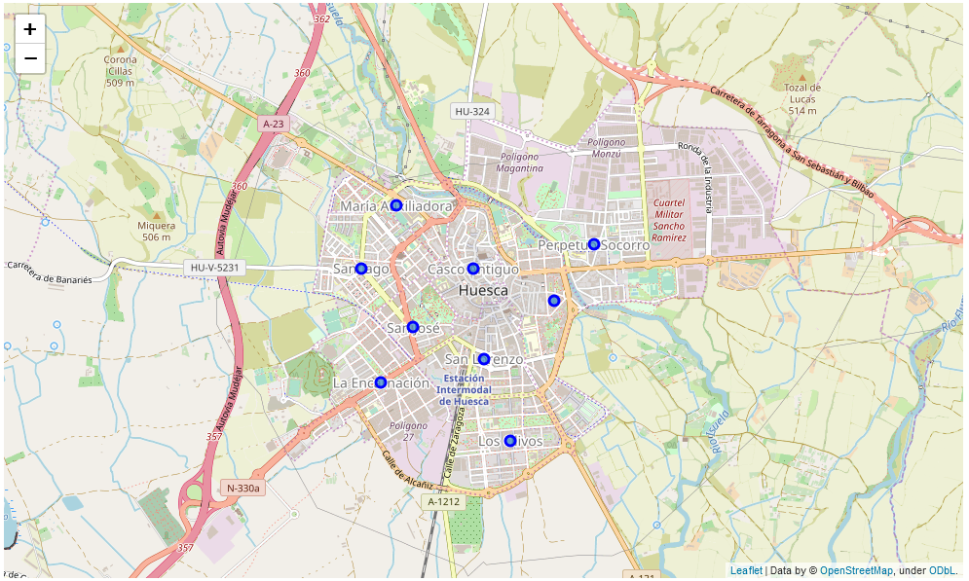
3. Methodology
Here we describe the workflow used:
Data collection (CVS file)
Get geographical location for each neighborhood (Using geopy)
Neighborhood geolocations

Slide 6
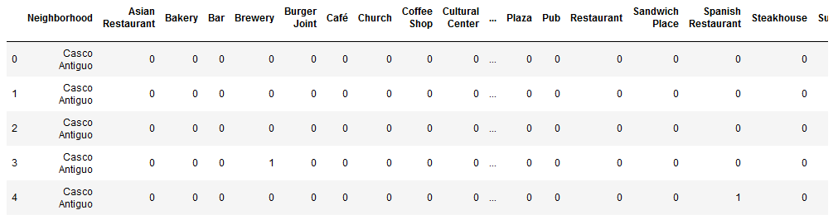
3. Methodology
Request venues information from Foursquare API
Determine the number of venues for each neighborhood in Huesca using groupby method over the variable neighborhood on Huesca_venues DataFrame. Also determine the number of unique venues using the unique() method on Huesca_venues over the variable Venue Category.
Perform one hot encoding on Huesca_venues DataFrame over the variable Venue Category using the Pandas function get_dummies.
One hot encoding example for the DataFrame.

Slide 7
3. Methodology
Group rows by neighborhood and take the mean of the frequency of occurrence of each category, in order to obtain the principal venues categories in Huesca for each neighborhood.
Get the top 10 venues for each neighborhood.
Perform cluster analysis using K-means clustering algorithm, whom is a clustering method, which aims at partitioning a set of n observations into k-groups in which each observation belongs to the group whose mean value is closest.

Slide 8
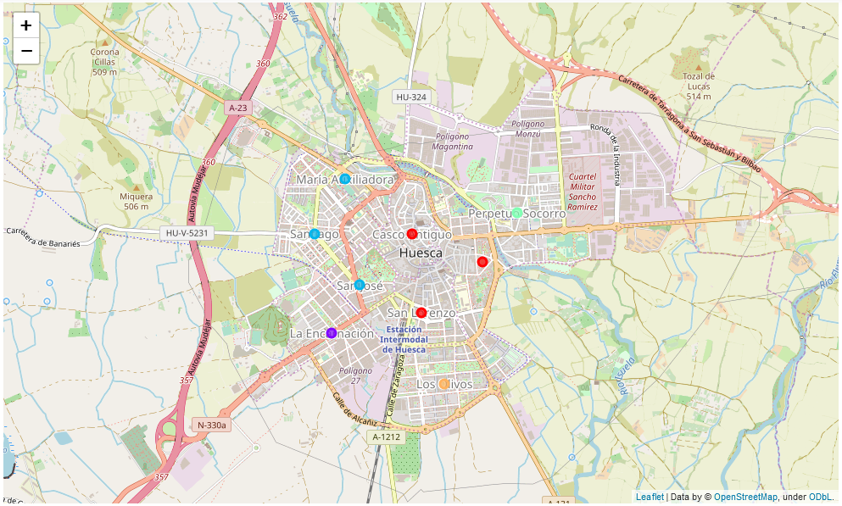
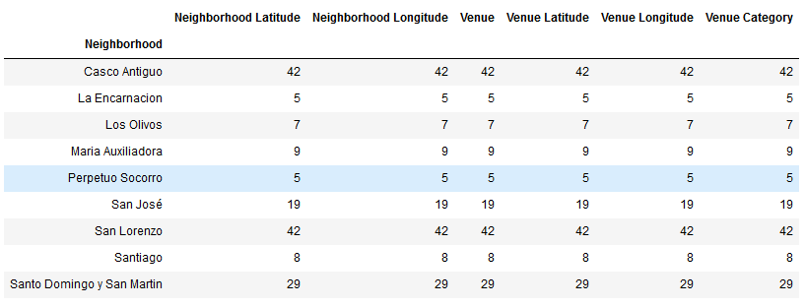
4. Results
Note that the most important places (in function of number of venues) are Casco Antiguo (42), San Lorenzo (42) and Santo Domingo y San Martin (29). This result is very important since it implies a greater movement of people in the city, which from the point of view of starting a restaurant business is favorable.
k-means algorithm, in total we have 5 clusters well differentiated.

Slide 9
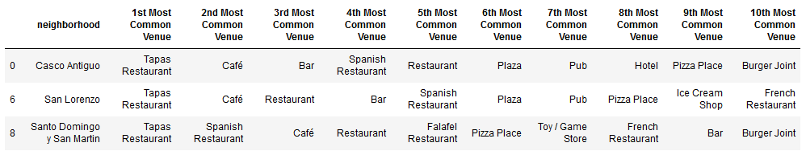
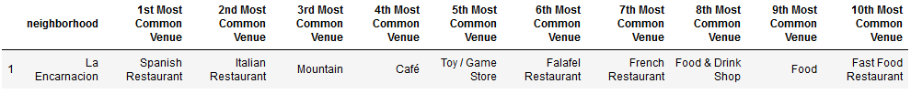
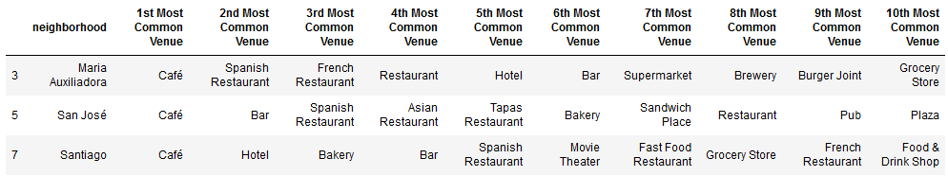
4. Results
Cluster 1.
Highest number of venues in the city, so our restaurant should be located in these neighborhoods since they are very busy places.
Cluster 2.
Less number of venues (5), is clearly a residential neighborhood and part of an industrial area.
Cluster 3.
Medium number of venues, coffee shops predominate, government offices and residential areas are concentrated

Slide 10
4. Results
Cluster 4.
lowest number of venues (5) composed of industrial and residential areas. The predominant venues are cafe and grocery stores.
Cluster 5.
Low number of venues (7) and is the newest area of the city with a net residential growth, the main venues are cafes.

Slide 11
5. Dicussion
According to the results shown in the previous sections, the neighborhoods of Casco Antigo, San Lorenzo and Santo Domingo y San Martin are the most suitable to start a business in the restaurant area, they have a high number of people and are the most transient in the city. Even the neighborhood of San Lorenzo is the most populated with a total of 13091 inhabitants representing 25% of the population of Huesca.
Another important aspect in this project is to determine the type of restaurant to be opened. Analyzing the DataFrame of cluster 1 it can be seen that mainly these neighborhoods are full of tapas restaurants, bars and cafes, so there is a very good opportunity to open an Italian food restaurant in these areas since there are very few in the areas.
Based on the above, it is recommended to open an Italian food restaurant in the San Lorenzo neighborhood.

Slide 12
6. Conclusions
Based on the methodology followed in this project to perform a segmentation analysis of the neighborhoods of the city of Huesca to start an entrepreneurship in the restaurant sector is concluded that the best option to be successful is to open an Italian restaurant in San Lorenzo neighborhood located in the Cluster 1 obtained by the k-means algorithm ran over the DataFrame build with the Data provided mainly by Foursquare.

